Slide 1

Mexico’s New Energy Model:
Key Elements of the Reform
October, 2014
Ministry of Energy

Slide 2

MAIN ASPECTS OF THE ENERGY REFORMS
This Energy Reform, the most transcendent one in eight decades, grants Mexico a new energy Model.
Hydrocarbons
Electricity
    Attract new capital and state of the art technology.
    Access to deep-water and non-conventional reservoirs.
    Increase natural gas and oil supply.
    A new wholesale electricity market is created.
    Equal conditions for public and private companies.
    More market participants will result in competitive prices.
Sustainability and Human Rights
    Environmental protection and promotion of clean energy.
    Extractive activities in protected areas are forbidden.
    Informed participation of host communities, and fair distribution of the economic benefits derived from energy projects.

Slide 3
GUIDING PRINCIPLES
The Constitutional Reform was based on six guiding principles:
1
The hydrocarbons contained in the subsoil belong to the Nation.
2
Free market access and direct competition amongs State Owned Enterprises and private companies.
3
Strengthening of the regulatory bodies.
4
Transparency and accountability.
5
Sustainability and environmental protection.
6
Maximize Mexico’s revenues and its long term development

Slide 4
THE EVOLUTION OF THE ENERGY REFORM
Constitutional Reform
On August 14, 2013, the Executive Office presented a Constitutional Reform proposal.
Secondary Legislation
On April 30, 2014, the Executive presented 9 energy bills to the Congress.
In a special session the Congress approved the proposed secondary legislation.
The Congress debated and approved the Constitutional Reform.
On December 20, 2013, the Constitutional Reform was enacted.
24 State Congresses approved the Reform.
On August 11, 2014, the Executive enacted the secondary legislation.
Implementation
On August 13, 2014, Round Zero results were presented and the areas that will be up for bids in Round One were announced.
On August 28 CENACE and CENAGAS were created and their directors appointed.
On August 12, 2014, the new legal framework (9 new laws and 12 modifications to existing ones) was enacted the day after its publication in the Official Gazette.
September 18: The Independent Counselors of PEMEX, CFE and the Mexican Oil Fund, as well as the new Commissioners of the CRE and CFE were ratified by the Senate.
September 28: CENACE’S Board of Directors was installed.
September 30:The funds for the Energy Sector were established
October 7: Pemex’s Board of Directors was installed

Slide 5
CONTENT
NEW INSTITUTIONAL ENVIRONMENT
EXPLORATION AND EXTRACTION
INDUSTRIAL TRANSFORMATION
NATURAL GAS
ELECTRIC INDUSTRY
CLEAN ENERGY AND GEOTHERMAL
LAND OWNERS RIGHTS
INVESTMENTS AND BENEFITS
SCHEDULE

Slide 6









NEW INSTITUTIONAL ENVIRONMENT
The institutional framework is strengthened through the creation of new public agencies and the reinforcement of the existing ones.
Energy Coordinating Council
New and reinforced regulatory agencies
State Productive Enterprises
Technical bodies in charge of creating new markets
Government bodies with new powers
Will issue recommendations and approve coordination mechanisms to ensure the fulfillment of the energy policy
Clear rules
Specific tasks
Checks and balances guaranteed by the interaction between government agencies
*ANSIPA: National Agency for Industrial Safety and Environmental Protection of the Hydrocarbons Sector

Slide 7
Participate and compete in almost all activities of the energy sector .
STATE PRODUCTIVE ENTERPRISES
New Legal Framework
    Pemex and CFE will no longer be decentralized public bodies and will become State Owned Productive Companies 100% owned by the State.
    They will have budgetary and operating autonomy. Only limited by debt and payroll ceilings.
    The Board of Directors will be designated according to the best international practices regarding corporate government.
    Independent Part-Time Board Members will be ratified by the Senate.
    The new tax regime related to entitlements and contracts will present similar tax conditions to those applicable to any company in the oil industry.

Slide 8
They are responsible for regulating, supervising and sanctioning both public and private companies.
COORDINATED ENERGY REGULATORS
Stronger Regulators
    Operational and Technical autonomy
    Budgetary stability and security.
    Will also receive an income derived from service fees and rights payments.
    They will guarantee that all the procedures related to the bids, contracts and permits are carried out with complete transparency and under strict checks and balances.
    They will collaborate with the authorities in charge of promoting competitive markets, to ensure the efficiency of the energy markets.

Slide 9
The new National Agency for Industrial Security and Environmental Protection of the Hydrocarbons Sector will be responsible for regulating, supervising and enforcing the law within the energy sector.
INDUSTRIAL SECURITY AND ENVIRONMENTAL PROTECTION
Industrial and Operational Safety
  Prevent and contain spills and hydrocarbon leakages at the facilities.
  Guarantee the physical and operational reliability of the facilities (e.g. wells, platforms, pipelines)
  Design and follow-up emergency plans to prevent and address emergencies.
  Perform a root cause analysis of incidents and accidents.
  Adopt and enforce national and international technical standards.
  Guarantee that the operators have financial resources to address contingencies.
Environmental Protection
  Protect, preserve, and restore the related ecosystems and natural resources.
  Waste management.
  Pollutant emissions control.
  Provide technical elements for the design of environmental and energy public policy.

Slide 10
TRANSPARENCY AND ACCOUNTABILITY
Institutional checks and balances framework (SENER, CNH, SHCP and the Mexican Petroleum Fund).
Bidding rounds’ procedures. The results will be announced in public sessions.
The Contracts and all the related payments information will be publicly available.
External auditing systems to guarantee an effective cost recovery.
All their Sessions, Agreements and Orders will be published.
The Commissioners will not be allowed to intervene in cases where conflicts of interest might arise.
At least two commissioners must be present at the meetings between the regulators and regulated parties, and meeting records must be disclosed.
Ethics Code (prohibiting Commissioners and Staff from accepting any and all per diem allowances, travel tickets, or gifts)
Publish their information according to the Mexican Stock Market Act, disclosing the financial situation of the State Owned Productive Enterprises, its affiliates and subsidiaries.
Exploration and Production Bids and Contracts
Coordinated Regulatory Agencies
(CNH y CRE)
State-Owned Productive Enterprises

Slide 11
CONTENT
NEW INSTITUTIONAL ENVIRONMENT
EXPLORATION AND EXTRACTION
INDUSTRIAL TRANSFORMATION
NATURAL GAS
ELECTRIC INDUSTRY
CLEAN ENERGY AND GEOTHERMAL
LAND OWNERS RIGHTS
INVESTMENTS AND BENEFITS
SCHEDULES

Slide 12
ENTITLEMENTS AND CONTRACTS
Entitlements (Round 0)
  Will be exceptionally awarded to Pemex to allow the State to participate in strategic projects.
Exploration and Extraction Contracts (Round 1)
  Can be signed with State Owned Productive Enterprises (SOPE), with SOPE in association with private companies, or with private companies.
  Administrative termination due to force majeure.
  International arbitration will follow Mexican legislation and will be carried out in Spanish.
  Mining concessioners will be able to obtain a contract (without the need of a bidding process) to extract Coal Bed Methane contained in carbon mines already in production.
  Booking of expected profits for accounting and financial purposes, only if they clearly state that all the hydrocarbons contained in the subsoil are owned by Mexico.
  The state can choose to participate directly in specific E&E contracts for three main reasons: (1) when fields coexist (2) to promote technological transfer, and (3) when the State has an economic interest.
Trans-boundary Hydrocarbon Reservoirs
  Pemex will have a direct 20% participation in contracts related to areas where trans-boundary reservoirs are located. The purpose is to ensure that the State is part of these projects and to promote the technology transfer between Pemex and private companies.

Slide 13

DISTRIBUTION OF FACULTIES IN THE CONTRACTUAL PROCESS
Selection of Areas with Assistance of CNH. PEMEX and privates can nominate them.
Awards and revokes assignations.
Establishes the applicable type of contract.
Designs the contracts and establishes the bidding terms (with opinion from COFECE for pre qualification and adjudication mechanisms.
Establishes the fiscal terms of the contracts and biddings.
Determines the adjudication variables.
Supervises the costs accountability
Conducts the bidding contracts
Subscribes, administers and supervises contracts
Authorizes dwell perforations
Authorizes and supervises exploration and development plans
Authorizes seismic studies
Administers the sector’s data

Slide 14
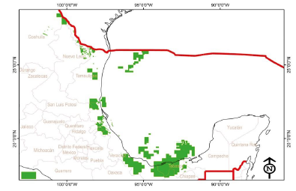
ROUND 0
As a result from Round 0, PEMEX was awarded with a balanced and diversified portfolio of
assignations
Reserves and prospective resources assigned to Pemex
Type | Volume (mmbpce) | Percentage Assigned | Percentage of the Total | Surface (km2) | Production years
2P Reserves | 20,589 | 100% | 83% | 17,010 | 15.5
Prospective Resources | 22,126 | 67% | 21% | 72,897 | 5
Conventional | 18,222 | 70.9% |  | 64,489
Unconventional | 5,225 | 58.8% |  | 8,408
Total | 42,715 |  |  | 89,907 | 20.5
PEMEX could produce at least 2.5mbpd for the
next 20.5 years.
PEMEX can now participate in bidding contract rounds
that Mexico signs, or receive from it, additional
assignations in the future (exception)
PEMEX will be strengthened with the competition
and collaboration with other companies

Slide 15
ROUND 1
Round’s 1 proposal consists in a balanced portfolio of areas and blocks of diverse characteristics, that range from opportunities of exploration in areas that are currently under production, to other areas relatively little explores in prospective resources. It also contemplates a high prospective potential in unconventional deposits.
Round 1 in Numbers
109 blocks for exploration and 60 for extraction of hydrocarbons.
28,500 km2 of surface.
Represents an approximate annual investment of $8,525mdd between 2015 and 2018. Considering the associations with PEMEX, an annual investment of $12,625 mdd is expected.
Includes around 4,000 mmbpce of total reserves.
Prospective potential of 1,600 mmbpce in deep waters

Slide 16
Key Indicators – Round 1 and “Farm-outs”
Round 1
Type | Blocks | Surface | Volume | Estimated Investments in 4 years | Estimated annual investments
Exploration (prospective) | 109 (91%) | 25,903km2 | 14,606 mmbpc | 19,000 mdd | 4,750 mdd
Production (2P Reserves) | 60 (9%) | 2,597kn2 | 3,782 mmbpc | 15,100 mdd | 3,750 mdd
Total | 169 | 28,500km2 | 18,388mmbpc | 34,100 mdd | 8,525 mdd
Farm-outs are the the migration process from assignations to contracts, as part of Round 1. For these cases, Pemex will seek one or more partners to participate jointly in the new contract
Blocks | Type | Volume | Estimated 4 year investment | Estimated annual investment
14 fields (10 contracts) | Reserves 2P | 1,557 mmbpc
 | Prospective | 2,664 mmbpc
 | Total | 4,221 mmbpc | 16,400 mdd | 4,100 mdd
The estimated total investment for Round 1 and Farm-outs is 12.6 billion dollars a year, that is, 50.5 billion dollars from 2015-2018.

Slide 17
NATIONAL CONTENT
Entitlements and Contracts
  National content requirements for entitlements and contracts must be met throughout the duration of the projects.
  The goal is to achieve a 35% share of national content, on average, by 2025, excluding deepwater.
  The Ministry of Economy will be responsible of enforcing the national content rule, and CNH will impose sanctions in case of non-compliance.
Industrial development and direct investment promotion strategy
  A specialized unit within the Ministry of Economy will be in charge of defining the methodology to measure and supervise the compliance with the required national content percentages.
  A Public Trust for the Promotion and Development of the National Energy Industry Suppliers and Contractors will be created.
  An Advisory Council chaired by the Ministry of Economy and composed by SENER, CNH, CRE, and industry and academy representatives will be established.
  Promote training programs and the certification of related companies.

Slide 18
VALUE CHAINS
The Mexican government will promote the development of regional and local value chains.
Public Trust for the Promotion and Development of the National Energy Industry Suppliers and Contractors
Strategy to promote value chains
National Content
Instruments
Mexican companies that offer similar conditions regarding prices, quality, and lead times will be preferred.
A strategy to develop local supply chains will be created.
The Public Trust for the Promotion and Development of National Energy Industry Suppliers and Contractors will be established.
Special funds to guarantee universal electrical service and the development of human resources will be created.
Benefits
The construction of Los Ramones Face II Pipeline (from Nuevo León to Guanajuato) will employ over 6,000 people.
For every person employed in the intermediate petrochemical industry, 8 more jobs are created in the final production chain, and 14 in the manufacturing industry.
With the strategic guidance of the State, public policies will be implemented to emulate the success stories of the auto, electronic, and air and space industries in the oil and gas industry .

Slide 19
MEXICAN PETROLEUM FUND FOR STABILIZATION AND DEVELOPMENT
    The State will manage oil revenues through a fund hosted by Mexico´s Central Bank, named the Mexican Petroleum Fund for Stabilization and Development.
Technical Committee
  Two representatives of the Federal Government: The Minister of Finance (presiding) and the Energy Minister.
  The Governor of Mexico´s Central Bank
  Four independent members proposed by the Executive and ratified by the Senate.
Key Roles
  The Fund will receive the State’s revenue derived from leases and contracts (excluding taxes such as Income Tax, VAT, etc.).
  The Fund will receive all the cash payments related to the entitlements, contracts and licenses.
  In the case of production sharing and profit sharing contracts, the State will receive payments in kind (oil and gas). So following the Fund’s instructions, the CNH will hire a trader to sell this oil and/or gas through a bidding process.
  Manage the account and pay the contractors.

Slide 20
MEXICAN PETROLEUM FUND FOR STABILIZATION AND DEVELOPMENT
  Its first objective will be to provide funds for the federal budget for up to 4.7% of GDP.
  The remaining income will be invested in long term savings, until they reach 3% of GDP.
  After reaching this threshold, 60% of the surplus will be used for specific items (in shares determined by law) and the remaining 40% will be destined for long term savings.
1
2
3
Universal Pension System
10%
1
10%
Public Budget
(Constant at 4.7% of GDP, including income tax)
When savings exceed 3% of GDP, the surplus will be used as fallows:
Science , technology and renewable energy projects
3
As an investment tool for oil and infrastructure development projects
30%
Up to 60% of the annual increase
Long term savings
2
10%
Scholarships, connectivity projects and the development of regional industries
At least 40% of the annual increase

Slide 21
NEW TAX REGIME
    The State Owned Productive Enterprises will benefit from the new tax regime and become more competitive.
  Each year, Pemex will save approximately 6.9 billion USD* in taxes.
  Instead of paying 9 separate fees, it will pay 3 fees and an income tax.
  The net income tax rate is reduced from 71.5% to 65%.
  Higher tax deductibility of the extraction real costs : 1) 12.5% for land and shallow water fields​​; 2) up to 60% of the value of nonconventional oil, such as Chicontepec and deepwater.
  If Pemex chooses to convert its entitlements into contracts, the same tax structure applicable to the contracts signed under the new legislation will apply.
CFE will no longer pay the current 9% tax on its net fixed assets.
It will only pay the applicable Income Tax, just as any other company
Labor Force related Liabilities
    The government may assume a share of the liabilities related to the pensions and retirement funds of both companies’ workforces, provided that in the next year they change their current pension system.
* Considering an exchange rate of 13.06 MXN/USD

Slide 22
CONTENT
NEW INSTITUTIONAL ENVIRONMENT
EXPLORATION AND EXTRACTION
INDUSTRIAL TRANSFORMATION
NATURAL GAS
ELECTRIC INDUSTRY
CLEAN ENERGY AND GEOTHERMAL
LAND OWNERS RIGHTS
INVESTMENTS AND BENEFITS
SCHEDULES

Slide 23

THE NEW MODEL FOR HYDROCARBONS TRANSFORMATION, TRANSPORT, STORAGE, AND DISTRIBUTION
The Hydrocarbons Act established a new industrial framework regarding hydrocarbons’ logistics, which includes the following activities:
  Industrial transformation
  Transport, storage, and distribution
The New Model Objectives
Complete and open competition in the provision of goods and services
Clear separation of all industrial activities and identification of each participant role.
Open access
Competitive pricing in benefit of the end users
Other Features
All hydrocarbon related activities require permits.
The National Center for Gas Control (CENAGAS) will be in charge of operating the national pipeline and storage infrastructure system.
A gradual liberalization of the gasoline, diesel and LPG retail sector.

Slide 24
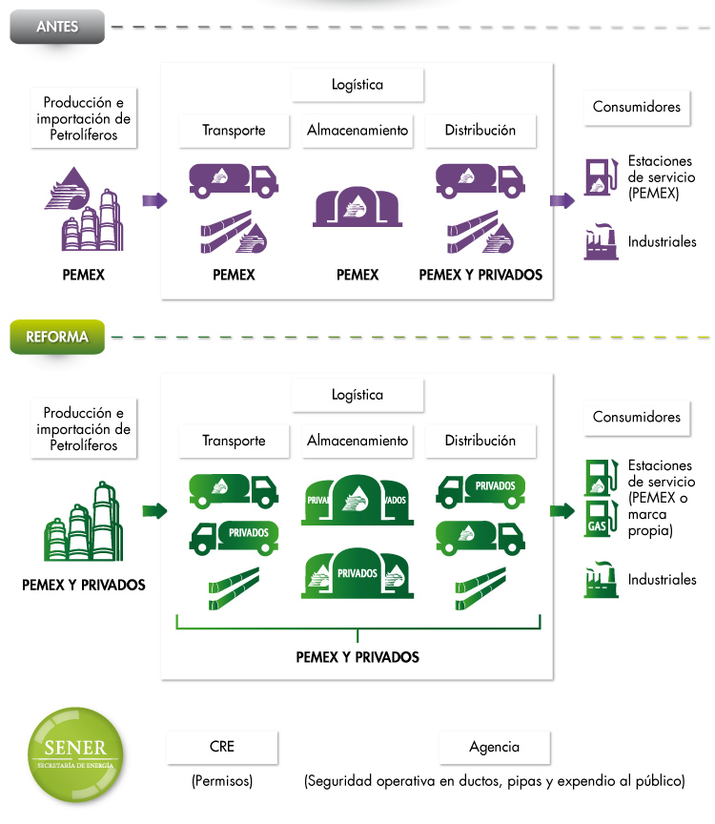

NEW OIL MODEL
Before
Industry Regulation
SENER will establish the public policy to ensure the adequate supply of oil products.
Issues permits for:
Oil refining
Natural gas treatment
Oil products imports/exports
Production Transport Storage Distribution Consumption
/Imports
Pemex and Privates
After
The CRE issues regulation to avoid unfair discrimination and guarantee open access to the pipeline system and storage infrastructure.
It sets fees for regulated activities.
It determines the criteria for infrastructure to qualify as self use.
Regulates end use retail activities if effective competitive markets don’t exist, in agreement with the Federal Commission for Economic Competition (COFECE).
It issues permits for the sales,
transportation, storage and distribution of
hydrocarbons and its products, and retail.
Production Transport Storage Distribution Consumption
/Imports
Pemex and Privates
Pemex and Privates
SENER
Agency
(Permits)
(Permits)
(Operational safety)

Slide 25
GRADUAL LIBERALIZATION OF GASOLINE AND DIESEL
Gasoline and diesel are to be sold by Pemex franchises or other brands from 2016 onwards.
The liberalization of the gasoline and diesel retail sector will be done in stages.
Products will be sold by Pemex and other suppliers.
2014
2015
2017
2018
Controlled monthly price increases.
Price ceilings for gasoline and diesel, set according to inflation.
Prices set by market conditions.
9 cents (MXN) for Magna gasoline
11 cents (MXN) for Premium gasoline
Open imports
2017 onwards
11 cents (MXN) for Diesel
Final sales: Pemex and different brands
2016 onwards
Imports : exclusively by Pemex
2014-2016

Slide 26
CONTENT
NEW INSTITUTIONAL ENVIRONMENT
EXPLORATION AND EXTRACTION
INDUSTRIAL TRANSFORMATION
NATURAL GAS
ELECTRIC INDUSTRY
CLEAN ENERGY AND GEOTHERMAL
LAND OWNERS RIGHTS
INVESTMENTS AND BENEFITS
SCHEDULES

Slide 27


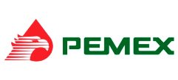
Midstream and Downstream
THE NEW NATURAL GAS MODEL
New Natural Gas Industry Model
Natural Gas Production
Transportation
CENAGAS
Functional Separation
Consumption (end users)
Commercialization and Imports
Independent Transmission System Operation
CENAGAS
Objectives
New rules
  Enhanced energy security
  Infrastructure development
  Open access to all producers
  Guaranteed fuel supply
  Controls to prevent monopolistic behavior in gas transportation.
  Centralized planning, authorized by the Ministry of Energy in consultation with the Energy Regulatory Commission
  Stronger institutions
  CENAGAS will tender strategic projects through open and transparent bidding processes.

Slide 28
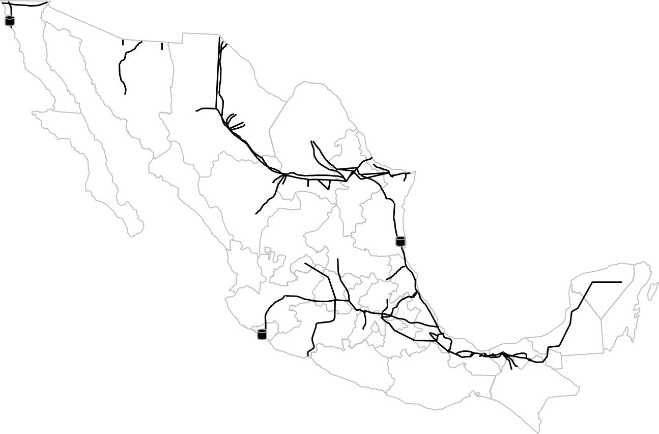
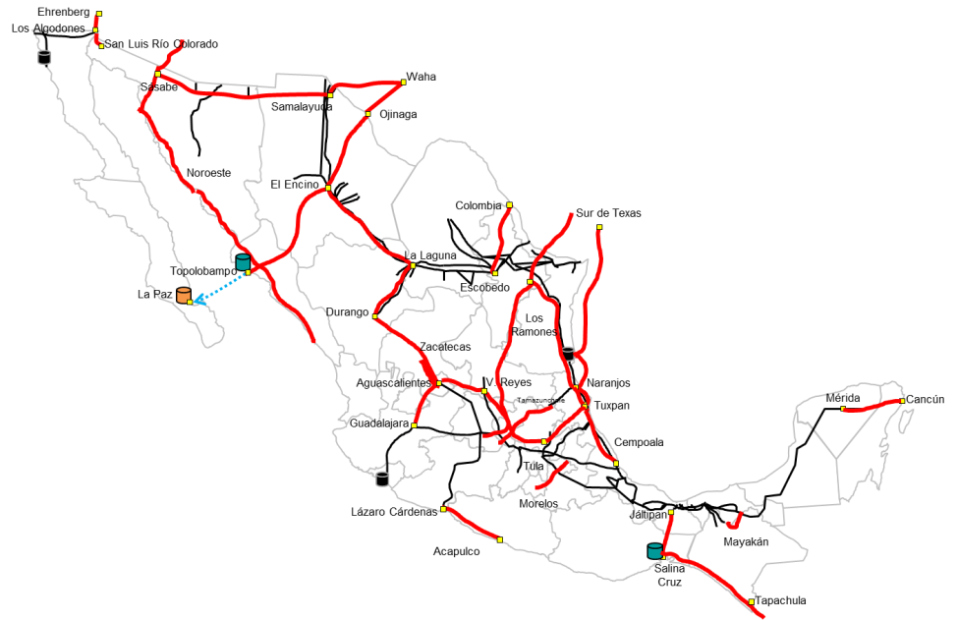
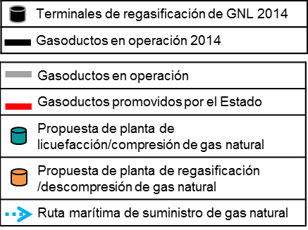
NATURAL GAS TRANSPORT INFRASTRUCTURE PLANS (2014 – 2018)
Current layout
2018
LNG regasification terminals 2014
Operating pipelines, 2014
Operating pipelines
State financed pipelines
NG liquefaction/compression plant proposal
NG regasification/decompression plant proposal
NG maritime supply route
New Opportunities
  18 natural gas transport projects.
  10,000 km of additional pipelines.
  An expected investment of 13.3 billion USD.

Slide 29
CONTENT
NEW INSTITUTIONAL ENVIRONMENT
EXPLORATION AND EXTRACTION
INDUSTRIAL TRANSFORMATION
NATURAL GAS
ELECTRIC INDUSTRY
CLEAN ENERGY AND GEOTHERMAL
LAND OWNERS RIGHTS
INVESTMENTS AND BENEFITS
SCHEDULES

Slide 30


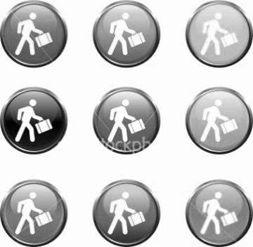





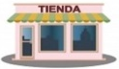



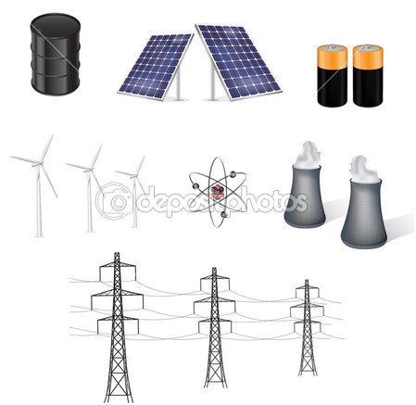
ELECTRIC INDUSTRY: THE NEW MODEL
Generation
Independent System Operator
Commercialization
Consumption
Qualified users
CENACE
Cogeneration
Basic users
IPP´s
Contract with
Private sector
Transmission
Distribution
Private investment is allowed in the power generation sector through three schemes: independent generation, cogeneration, or contracted by CFE.
Private investment is welcome in the transmission and distribution sectors, contracted by CFE.
A decentralized public entity, CENACE, will control dispatch and manage the wholesale market.

Slide 31
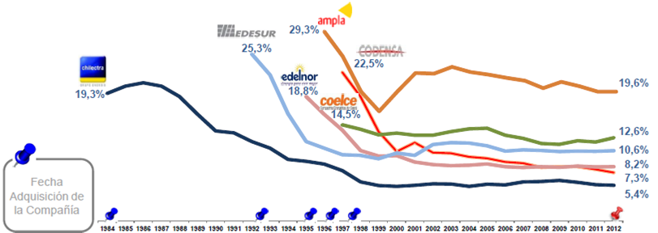
COMPETITIVENESS IN THE ELECTRIC INDUSTRY
The new legal framework will catalyze the investment in more efficient generation facilities, which will reduce the overall costs of the National Electric System.
By hiring third parties, the loss in transmission and distribution will be reduced.
Fuel Oil Substitution
Loss Reduction
Brazil
Argentina
Chile
Brazil
Colombia
Perú
1984
1991
1998
2005
About 15.9% of the electricity is generated from fuel oil, which is 3-5 times more expensive than natural gas.
The total share of fuel oil based power generation can be reduced by 7% in 5 years.
In 2013, electricity losses represented 15% of the generated power.
In Latin America, the overhauling of the electric sector has invariably resulted in loss reduction.

Slide 32
INVESTMENT REQUIREMENTS IN THE POWER SECTOR
(PUBLIC AND PRIVATE)
Mexico will require at least 66 GW of new generation capacity in the next 15 years.
The required estimated investments will exceed 46 billion USD in the next few years, and reach 150 billion USD in the next 15 years.
Investment 2014-2018
(Billion USD)
Generation: $ 23.1
Transmission: $ 6.0
Distribution: $ 11.9
Maintenance: $ 5.5
-----------------
Total: $ 46.5
Pipelines: $ 17.4
(2013-2018)
Generation
Wind
3,616
Hydroelectric
2,750
Combined cycle
9,838
Turbo gas
338
New clean energy
2,380
Solar
899
Geothermal
260
Internal combustion
272
Rehabilitation
2,754
Total
$ 23,107

Slide 33
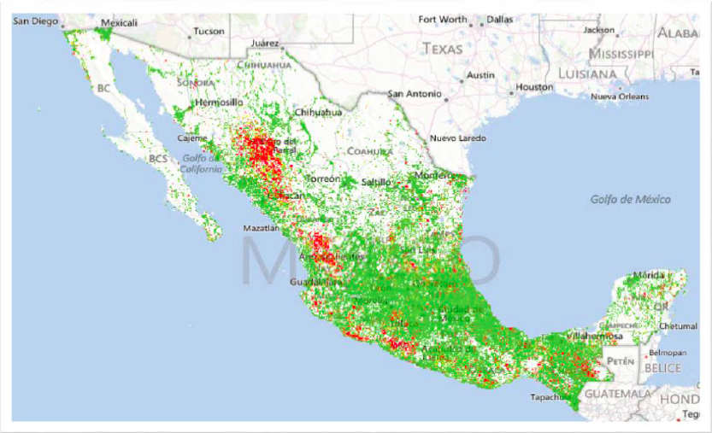
UNIVERSAL POWER SERVICE FUND
Current status
More than 2 million Mexicans lack access to the grid.
The electrification costs have increased.
CFE and the local governments cover these costs. Private power generators are excluded from this responsibility.
Universal Power Service Fund
The whole power industry will participate in the electrification process, not only CFE.
The electrification process will be expedited. Universal Service will be achieved in a decade.
Electrified communities
Communities with no access to the grid
Up to December, 2012

Slide 34
CONTENT
NEW INSTITUTIONAL ENVIRONMENT
EXPLORATION AND EXTRACTION
INDUSTRIAL TRANSFORMATION
NATURAL GAS
ELECTRIC INDUSTRY
CLEAN ENERGY AND GEOTHERMAL
LAND OWNERS RIGHTS
INVESTMENTS AND BENEFITS
SCHEDULES

Slide 35
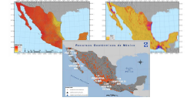
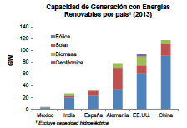
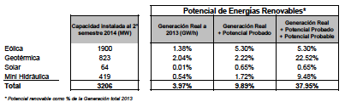
POTENTIAL FOR CLEAN ENERGY
Mexico hasn’t taken advantage of its potential in renewable energies, and has fallen behind
the rest of the world.
The potential in renewable resources is sufficient to exceed the goals, even without considering
the contribution of other types of clean energies, like nuclear or co-generation.

Slide 36
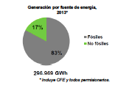
CLEAN ENERGIES AND ENERGETIC EFFICIENCY
Reform Solutions
Problematic
  Interconnection Markets
  Possible interconnection and sell of products in time and without over costs.
  Clean Energy Certificates
  Promotes low cost clean energy sources
  Distributed Generation
  Users with solar panels will be able to sell their energy to CFE or to other suppliers at regulated prices.
  Intelligent Demand
  The reduction in demand can be sold to CFE or to other suppliers.
  Geothermal Energy Law
  Use of energy from the subsoil
  Only 17% of the energy in Mexico is generated with non-fossil sources.
  Other countries like China, India or the US have made relevant progress in the incorporation of clean energies.
  To achieve the 35% goal of clean energies, Mexico requires the elimination of barriers and scheme promotions.

Slide 37
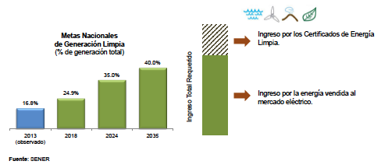
CLEAN ENERGY CERTIFICATES
Through the Clean Energy Certificates, the national goals will transform into individual
obligations.
Big consumers and suppliers will be obliged to acquire them in proportion to their
consumption.
They will be a stable source of income for clean generators, CFE and third parties.

Slide 38
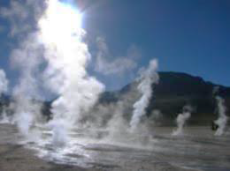

GEOTHERMAL ENERGY
The new Geothermal Energy Law regulates, in accordance to the best international practices, the stages of recognition, exploration and production of geothermal resources found in Mexico’s subsoil
Stages of geothermal activity
Recognition | Exploration | Production
Registration for 8 months without intrusive activities | 3 year (renewable) permit for an area of up to 150km2. | Concession for up to 30 years in an area up to 150 km2
Defines hydrothermal geothermal deposit to distinguish it from the conventional aquifers,
and allow for a specialized regulation.
CFE will have a Round O in geothermal energy, providing it with 120 days to determine the areas to develop.
In the not developed areas, CFE can form joint ventures with private companies. The rest of the projects can be put in bid by SENER

Slide 39
BIOENERGETICS
The new legal framework creates new opportunities for bioenergy
Biofuels
Bioelectricity
  The treatment and refining of oil and petroleum products, its transport, storage, distribution and public commercialization will no longer be exclusive for Pemex.
  The big consumers of gasoline and diesel will be able to produce biofuel that allows them to lower their energy costs.
  Also, the regions with high potential for fabrication of bioethanol or biodiesel will be able to participate in regional markets to attend the local demand of liquid fuels.
  The supply of a gasoline blend with 5.8% v/v of bioethanol (E6) in the 3 main cities of Mexico, will generate around 32 thousand new jobs*.
  Access to the National Transmission Grid, guaranteed by CENACE, will facilitate the interconnection of bioenergy projects based on solid residuals, municipals or agricultural waste.
  The creation of a Wholesale Electricity Market will facilitate the supply of energy in the market or through bilateral contracts with qualified users.
  Through the Clean Energy Certificates, the renewable energy projects will have a stable source of income.
  In Mexico, between 8,400 and 11,200 new jobs could be created to reach the goal of 1240 MW of generation capacity from biomass and biogas towards 2018*.
* Direct and indirect jobs considered

Slide 40
CONTENT
NEW INSTITUTIONAL ENVIRONMENT
EXPLORATION AND EXTRACTION
INDUSTRIAL TRANSFORMATION
NATURAL GAS
ELECTRIC INDUSTRY
CLEAN ENERGY AND GEOTHERMAL
LAND OWNERS RIGHTS
INVESTMENTS AND BENEFITS
SCHEDULE

Slide 41
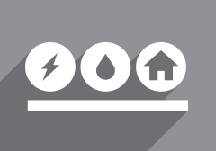
RESPECTING LANDOWNERS’ RIGHTS
A new paradigm for the establishment of fair agreements based on human rights.
Land Surface Occupation Regulation
The energy reform fosters a paradigm shift towards the construction of a wholesome energy sector, with stronger sustainability and human rights foundations, to achieve greater economic and peaceful development.
This shift places the communities at the center of the sector’s development, through schemes that guarantee their free and informed participation, and stronger mechanisms that ensure the fair distribution of the benefits derived from the energy sector activities.
The energy reform prioritized the construction of mechanisms that ensure fair negotiation conditions for the use and occupation of the land surface.

Slide 42
RESPECTING LANDOWNERS’ RIGHTS
The landowners will receive fair compensation related to the development of energy projects in their property.
New Mechanism
Types of compensation
The definition of terms and conditions for the use and benefit of the land, and the estimation of land or assets’ impact, will be based in fairness and transparency principles.
Initial negotiations with landowners will take up to 180 days.
SENER, SEDATU and PA will follow the process to guarantee the human rights protection using social witnesses, contract models, advisory and legal representation.
INDAABIN will have reference values, and will be able to request land valuations, to be performed by professionals, public accountants or financial institutions.
Payment for damages occurred in the land or related assets, calculated based on the original use of the property.
Rent payment for the occupation, serfdom or use of the land.
Income share payment, this is a percentage of the total income received by the contract holder when a project reaches commercial production.
The percentage will be between 0.5 and 3% for non associated natural gas projects, and between 0.5% and 2% for all other cases.

Slide 43
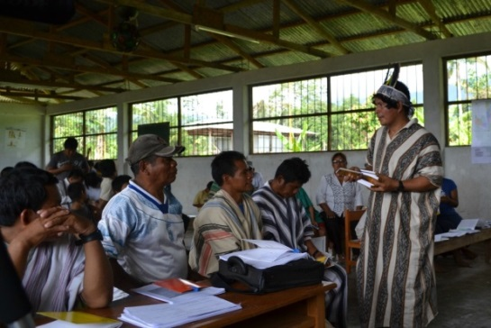

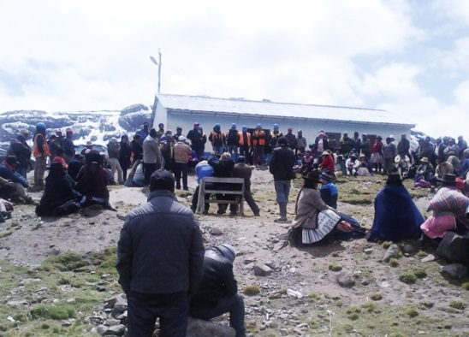
SUSTAINABILITY AND HUMAN RIGHTS
Social Impact Assessment
Free and informed Prior Consultation
To implement a sustainability and human rights respect criteria, there are four key instruments:
Social impact assessment within the potential entitlement and contract areas,
Social impact assessments per project,
Free and informed prior consultation when projects are to be developed in indigenous communities,
Mechanisms to regulate the land surface occupation.

Slide 44
CONTENT
NEW INSTITUTIONAL ENVIRONMENT
EXPLORATION AND EXTRACTION
INDUSTRIAL TRANSFORMATION
NATURAL GAS
ELECTRIC INDUSTRY
CLEAN ENERGY AND GEOTHERMAL
LAND OWNERS RIGHTS
INVESTMENTS AND BENEFITS
SCHEDULES

Slide 45
ESTIMATED INVESTMENT REQUIREMENTS
The National Infrastructure Program (PNI) estimates that the participation of the private sector will reach a least 27% of the total required investment in energy-related projects (≈20 billion USD per year from 2015 to 2018).
Investment requirements by project type (2013-2018)
Project type | Estimated investment (MMUSD)
Exploration and production | Total Private
 | 185,470 | 50,590
Transformation
 | 48,650 | 10,530
Petrochemicals
 | 3,855 | 985
Distribution and storage
 | 17,365 | 12,915
Power generation and retail
 | 23,760 | 6,320
Estimated investment in the energy sector (2013-2018)
Total | 298,000 MMUSD
Public | 216,660 MMUSD
Private | 81,340 MMUSD
Inversión anual de Pemex (2008-2012) | 266,451 mdp
Estimated investment by region (MUSD)
Northwest | 8,305
Center-West | 8,630
Center | 26,080
South-Southwest | 74,175
Northeast | 88,410

Slide 46
REGIONAL ECONOMIC ACTIVITIES
Expected economic activity and employment (2018)
Region | Regional GDP | Employment
Northwest | +0.56% | +42,475
Center - West | +0.61% | +114,022
Center | +0.52% | +134,027
South – Southeast | +2.01% | +137,686
Northeast | +2.36% | +70,832
A greater availability of natural gas, fuels and petrochemical products will contribute to the re-industrialization of all regions.
The State and the private sector will be able to invest in infrastructure development, the primary and secondary energy system operation, as well as transmission, transport, storage and distribution.
Fuel transport and storage infrastructure, as well as the power transmission network will grow to ensure adequate energy supply.
NATIONAL
GDP
:
2018 +1.0%
2025 +2.0
%
Employment: 2018 +500,00
2025 +2,500,000
Northwest
Northeast
Center
-
West
South
-
-Southeast
Center

Slide 47
CONTENT
NEW INSTITUTIONAL ENVIRONMENT
EXPLORATION AND EXTRACTION
INDUSTRIAL TRANSFORMATION
NATURAL GAS
ELECTRIC INDUSTRY
CLEAN ENERGY AND GEOTHERMAL
LAND OWNERS RIGHTS
INVESTMENTS AND BENEFITS
SCHEDULE

Slide 48
10 ACTION POINTS RELATED TO THE ENERGY REFORM
Immediate
Start working on Round1.
August, 2014
Issue the decrees for the creation of CENACE and CENAGAS.
September, 2014
Put into action the newly created National Agency for Industrial Safety and Environmental Protection of the Hydrocarbons Sector.
October, 2014
November, 2014
Accelerate Round 0.
Send the candidacies of CNH and CRE commissioners, Pemex and CFE independent counselors, and independent members of the Mexican Oil fund to the Senate.
Create the Mexican Oil Fund for Stability and Development.
Publish all the regulations related to the Secondary Laws of the Energy Reform.
Present the Strategic Program for the Development of Human Resources in the Industry, to be defined by SENER, SEP and CONACYT. The Program will include scholarships.
Present the decree for the restructuring and modernization of the Mexican Petroleum Institute.
Publish the methodology for the emission of Clean Energy Certificates (CLEs).

Slide 49
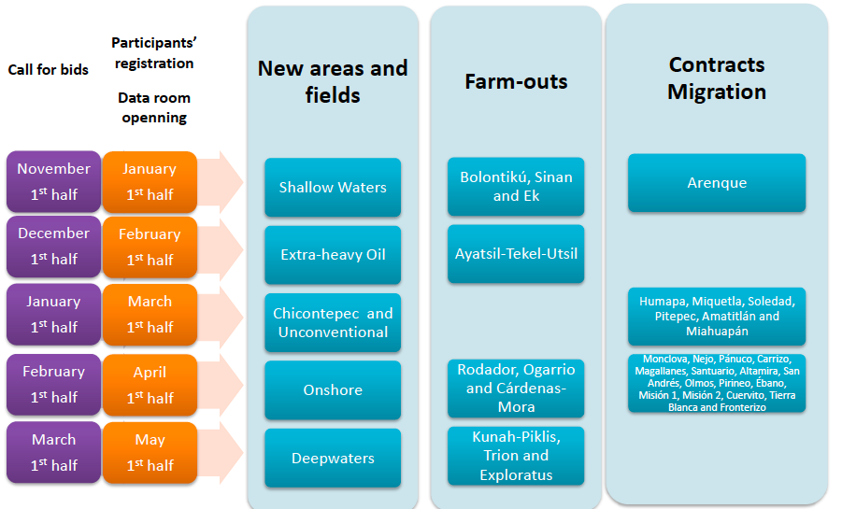
ROUND 1, MIGRATIONS AND FARM-OUTS

Slide 50
www.reformaenergetica.gob.mx www.sener.gob.mx http://www.energia.gob.mx/webSener/leyes_Secundarias/index.html http://www.energia.gob.mx/webSener/rondacero/index.html

