Slide 1

For Importing & Exporting

Slide 2
About us
El Deeb Trading Company for Importing & Exporting was established on 1988 , we are working seriously to present a line of quality HERBS, SPICES,PULP and many other products in a competitive quality with a competitive price and less delivering target.
We Have Factory in NAZLA IT’S SOURCE OF HERBS AND SPICES IN EGYPT
Our processes are controlled and verified by a series of procedures and control all the way from the field to the end-consumer through maintaining the highest level of quality as we garble our products manually. Our products are free of impurities, and the degree of purity of our products is 100%.

Slide 3
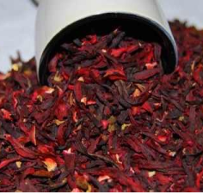
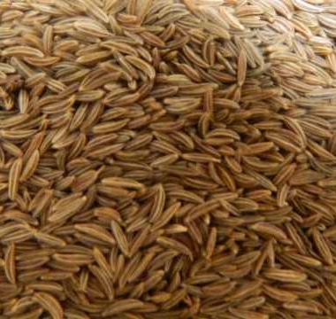
Product/Service:
1.Leaves
2.Seeds

Slide 4
Leaves
Basil Leaves
Spearmint Leaves
Peppermint Leaves
Molokai Leaves
Hibiscus Flower
Chamomile Flower
Celery Leaves
Lemon Grass Leaves
Parsley Leaves
Marjoram Leaves
Dill Leaves
Calendula Flower

Slide 5
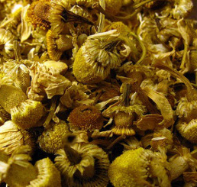
1. Chamomile Flower
Available In
Chamomile Tea Bag Cut
Chamomile 1st Quality (Flower only)
Chamomile 2nd Quality
Chamomile Petals
Chamomile Seeds
Chamomile Powder

Slide 6
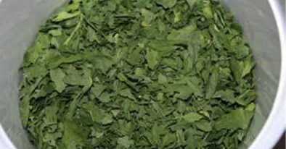
2. Parsley Leaves
Available In
Parsley Crushed
Parsley Powder

Slide 7
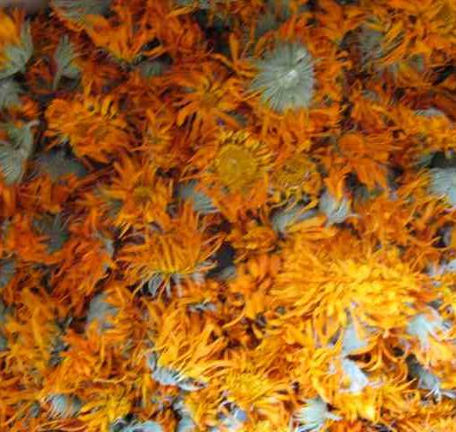
3. Calendula Flower
Available In
Calendula Petals
Calendula Tea Bag Cut
Calendula 1st Quality (Flower only)
Calendula 2nd Quality
Calendula Powder

Slide 8
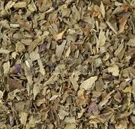
4. Basil Leaves
Available In
Basil Crushed
Basil Large Cut
Basil Powder
Basil Grade A Quality
Basil Grade B Quality
Basil Tea Bag Cut

Slide 9
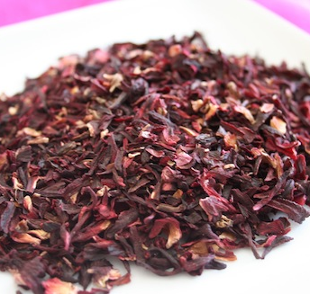
5. Hibiscus Flower
Available In
Hibiscus Whole Flowers
Hibiscus Crushed Flowers
Hibiscus Sifting Tea Bag Cut
Hibiscus Slice Flower Grade 1st

Slide 10
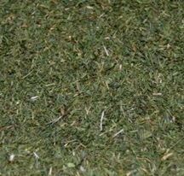
6. Dill Leaves
Available In
Dill Tips Crushed Leaves

Slide 11
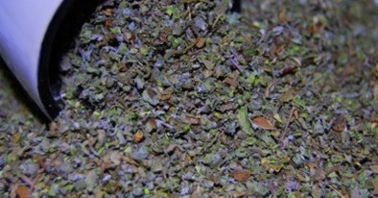
7. Marjoram Leaves
Available In
Marjoram Fine Cut
Marjoram Powder
Marjoram Crushed

Slide 12
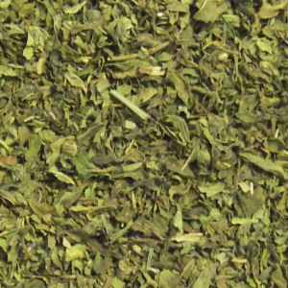
8. Spearmint Leaves
Available In
Spearmint Powder
Spearmint Crushed
Spearmint Fine Cut
Spearmint Large Cut
Spearmint Tea Bag Cut

Slide 13
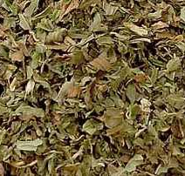
9. Peppermint Leaves
Available In
Peppermint Powder
Peppermint Crushed
Peppermint Fine Cut
Peppermint Tea Bag Cut
Peppermint Large Cut

Slide 14
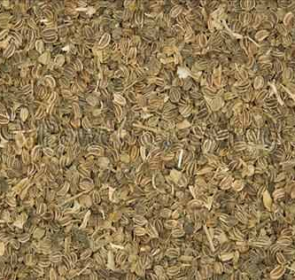
10. Celery Leaves
Available In
Celery Leaves Powder
Celery Leaves Crushed
Celery Leaves Fine Cut
Celery Leaves Large Cut

Slide 15
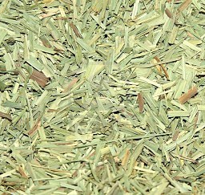
11. Lemon Grass Leaves
Available In
Lemon Grass Tea Bag Cut
Lemon Grass 5 Cm
Lemon Grass 1-2 Cm
Lemon Grass Cut (Siza as required)
Lemon Grass ½ Cm

Slide 16
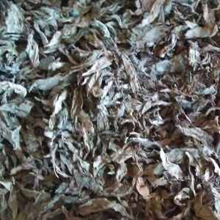
12. Molokai Leaves
Available In
Molokai Leaves Crushed
Molokai Leaves Fine Cut
Molokai Leaves Large Cut

Slide 17
Seeds
Fennel Seeds
Caraway Seeds
Dry Lemon
Fenugreek Seeds
Dill Seeds
Cumin Seeds
Coriander Seeds
Anise Seed

Slide 18
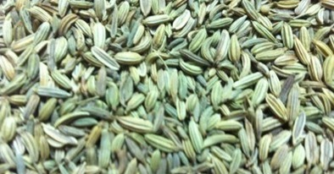
1. Fennel Seeds
Available In
Fennel Seeds Grade A Quality
Fennel Seeds Grade B Quality
Fennel Seeds Cracked Quality
Fennel Seeds Pure Powder
Fennel Seeds Small Seeds

Slide 19
2. Caraway Seeds
Available In
Caraway Seeds Grade A Quality
Caraway Seeds Grade B Quality
Caraway Crushed
Caraway Powder

Slide 20
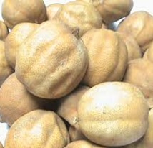
3. Dry Lemon(Black & Yellow )
Available In
Dry Lemon
Dry Lemon Crushed
Dry Lemon Powder

Slide 21
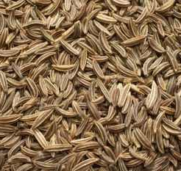
4. Anise Seeds
Available In
Anise Seed Grade A Quality
Anise Seed Grade B Quality
Anise Seed Tea Bag Cut

Slide 22
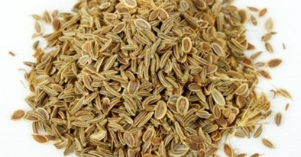
5. Dill Seeds
Available In
  Basil Seed Grade A Quality
  Basil Seed Grade B Quality

Slide 23
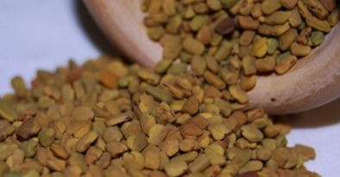
6. Fenugreek Seeds
Available In
Fenugreek Seeds Grade A Quality
Fenugreek Seeds Cracked Quality
Fenugreek Seeds Powder
Fenugreek Seeds Crushed

Slide 24
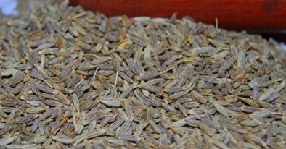
7. Cumin Seeds
Available In
Cumin Powder
Cumin Crushed

Slide 25
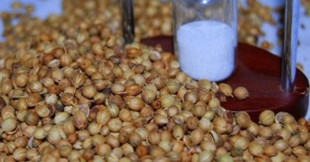
8. Coriander Seeds
Available In
Coriander Seed Crushed
Coriander Seed Powder
Coriander Grade A Quality
Coriander Grade B Quality

Slide 26
Other Products
NIGELLA SEEDS (Black Cumin seeds)/
sage (POWDER, CRUSHED, TEA BAG CUT)/
sun flower seeds for animal feed/
White Pumpkin pulp
Pumpkin (wood pulp)
Egyptian pulp
Lemon Leaves
Rose of Jericho
Safflower plant

Slide 27
Other Products
Licorice leaves & Licorice seeds‏/
Bitter Melon or Bitter apple
Saffron
Plant Alortp
Malva Parviflora
Purslane
Henna
Senna
kidney Beans ( White Beans)

Slide 28
Other Products
Handal
Caorb (POWDER, CRUSHED, TEA BAG CUT)
Olive leaves
Guava leaves
Laurel Leaves
bay leaves
SESAME SEEDS

Slide 29
Other Products
Rosemary
Barley
Alfa Alfa powder
Onion powder/(slices)
Carrot Powder
Tomato powder
Garlic powder
Turmeric
DUOM(ONLY IN EGYPT)

Slide 30
Ordering Information
Minimum order: 20ft container.
When placing an order please include the details below:
Units required - i.e. number of Ton
Full product name
Part of product required - i.e. root, flower, herb, etc
Packaging.
Delivery requirement : as per agreement

Slide 31
Cont. Of Ordering Information
Delivery charges & (INSURANCE)
All Delivery by over sea or plan
WE INSURE YOUR SELL PRODUCT From FACTORY TO YOUR PORT FREE
NOTE
Any Simple required HAVE Delivery charges
bank details.
Our preferred payment method is directly through our bank or L/C . For US.Dollar payments our bank details are as follows: A/C NO. 19660150 BANQUE DU CAIRE.ELZOHOUR BRANCH -NASR CITY- CAIRO - EGYPT swift code BCAIEGCX196

Slide 32
How To Contact Us
Orders can be taken between 24 Hour.
Telephone:- +2-01001699937
FAX:- +202-24045461
Factory address: EL NAZLA - FAYOUM - EGYPT.
Write to: El Deeb Trading Company, P.o.BOX 8320 - Nasr city, Cairo, Egypt.
Email: omar.eldeeb@dtcegypt.com
Website: www.dtcegypt.com

Slide 33
Our Policy
We are fully aware of the important roles of product’s quality. Thus, our company have been trying our best to gain the deepest belief as well as satisfying the full demands of our valued customers by applying and maintaining the Quality Management System as ISO 9001:2000 and ISO 9001:2008. We commit to implement as follow: 1. Supplying to our customers with the best quality, corresponding to the specifications of products showed signed contracts. 2. Maintaining the Quality Management System, complying the full requirements of ISO 9001:2000 and ISO 9001:2008& documents of El Deeb Trading Company for Export and Import.

Slide 34
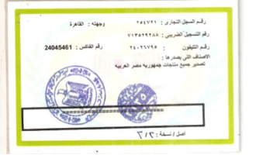
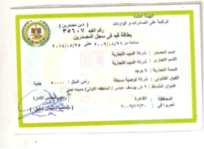
Cont. Of Our Policy

Slide 35
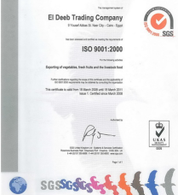
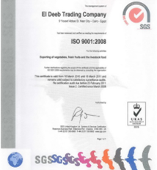
Cont. Of Our Policy

Slide 36


